Slide 1







amazon
Understanding Customer Reviews
Team Cape Town
Anan
Teresa
Shuyue
Andy
Cole
Fannie
Akif
Notes:
AKIF

Slide 2




Our team: Team Cape Town
Agenda
Overview
Data Driven Insights
Modelling Journey
Model Evaluation
LLM Integration
Key Takeaways
Notes:
AKIF

Slide 3


Our team: Team Cape Town
Overview
Challenge
Lots of reviews per product, making it difficult for customers to find useful, relevant information, to assist with their purchase decisions
Current Situation
Poorly Written Reviews Language & grammar errors make feedback difficult to decipher
Biased Reviews Incentivized by discounts or brand affiliation
Unverified Reviews
No authentication for whether reviewer purchased the product
Duplicated Reviews
Reposting positive or negative comments
Goal
Identify reviews which are helpful to customers in their purchase decisions and to Amazon to improve their product assortment
Notes:
AKIF

Slide 4
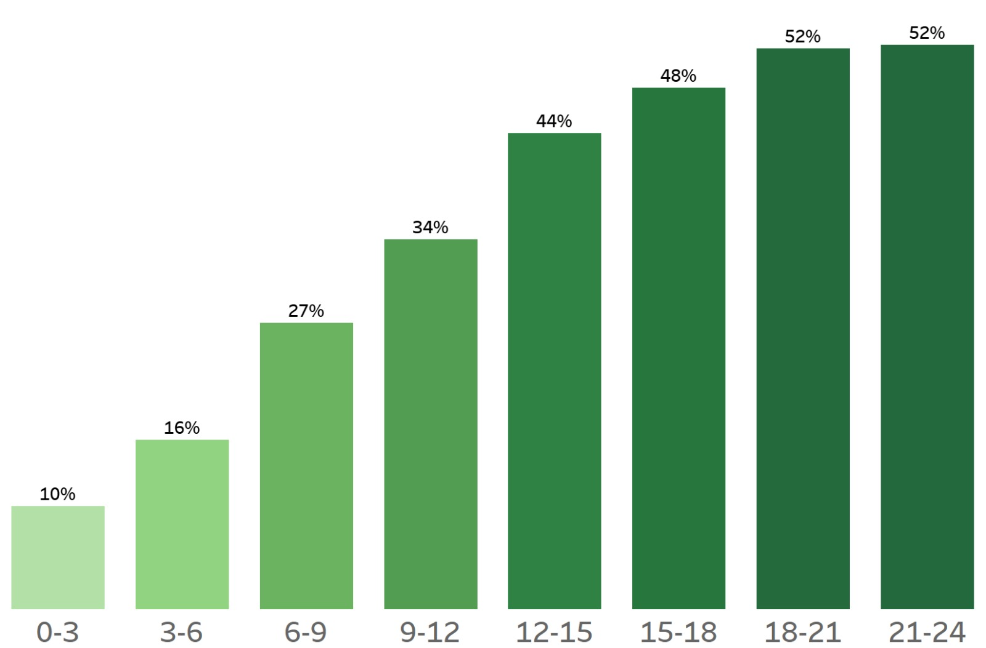


Our team: Team Cape Town
Data Driven Insights
Customer Engagement: More engaged customers leave useful reviews
Inactive
Highly active
As customer activity increases, so does their proportion of useful reviews.
% of Useful Reviews
Number of Reviews Per Customer Per Year
INACTIVE CUSTOMER
HIGHLY ACTIVE CUSTOMER
Increase in customer engagement
Notes:
FANNIE

Slide 5
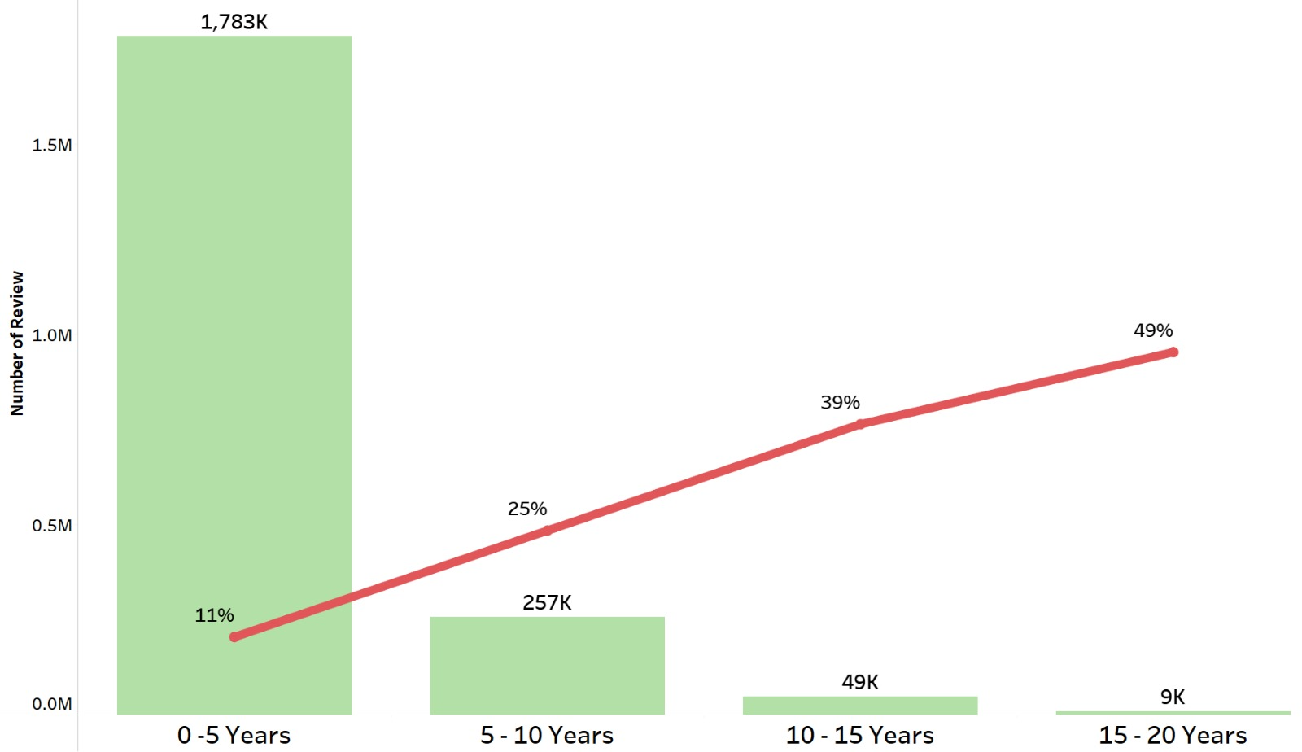
Our team: Team Cape Town
Data Driven Insights
Age of Customer Account*: Older accounts leave helpful reviews
% of Useful Reviews
Customers with newer accounts, leave more reviews, but are less likely to leave helpful reviews
Customers with an older account are more likely to leave helpful reviews, although they leave fewer reviews in general
Count of Customer Reviews
NEW CUSTOMER
Age of Customer Account*
TENURED
CUSTOMER
* This is a proxy for the age of a customer account, calculated as the time since the first review of a customer.
Notes:
FANNIE
Mention that the age of the customer account is just a proxy – to be calculated from first review

Slide 6
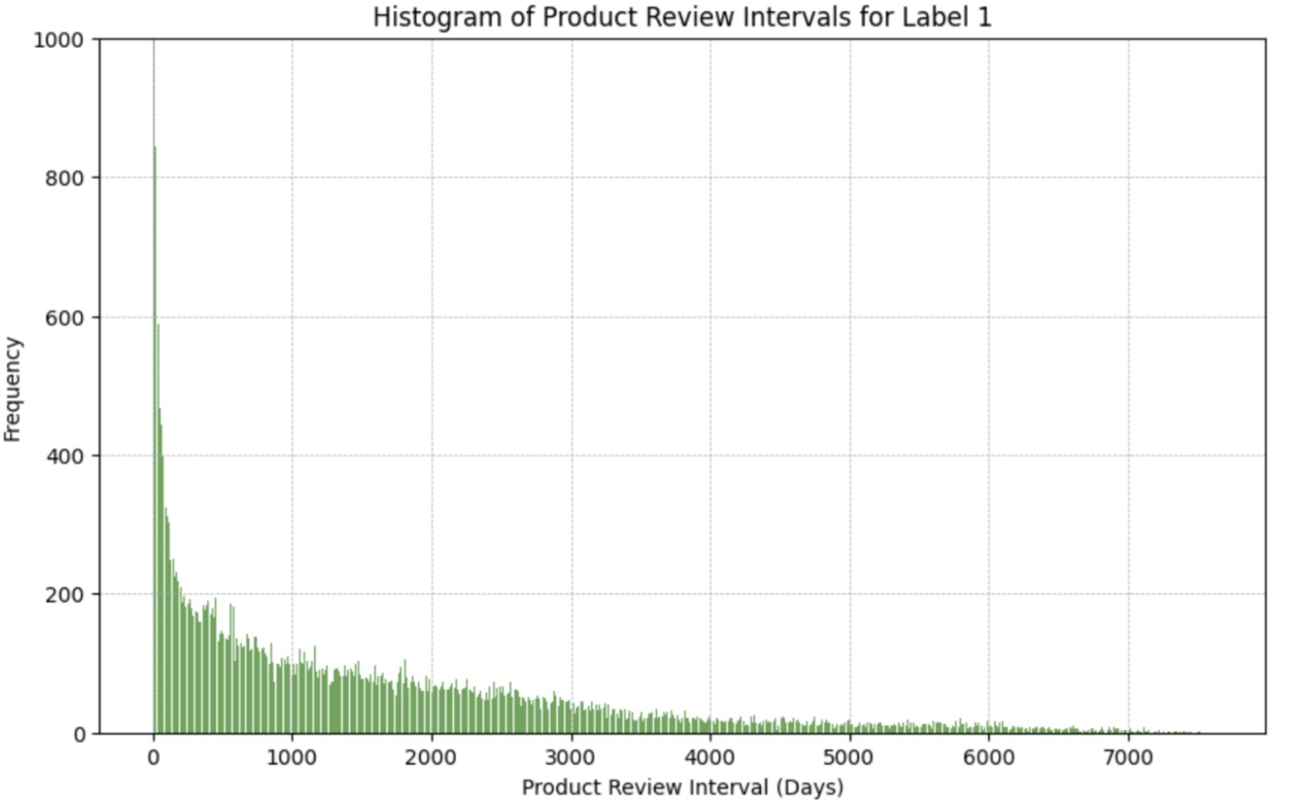
Our team: Team Cape Town
Data Driven Insights
Reviews Per Product: The initial reviews of a product are usually the helpful ones
The initial reviews of a product tend to be more helpful
Frequency of Useful Reviews
Drastic decline in helpful / relevant reviews the more a product ages
Review Interval Between Current Review & First Review (Days)
Notes:
FANNIE
Time since first review can be a proxy for when a product is introduced to Amazon’s assortment First days of a product – so the reviews are helpful. Nothing to benchmark against. But as more time goes on, the content becomes repetitive and the usefulness of the review declines.

Slide 7
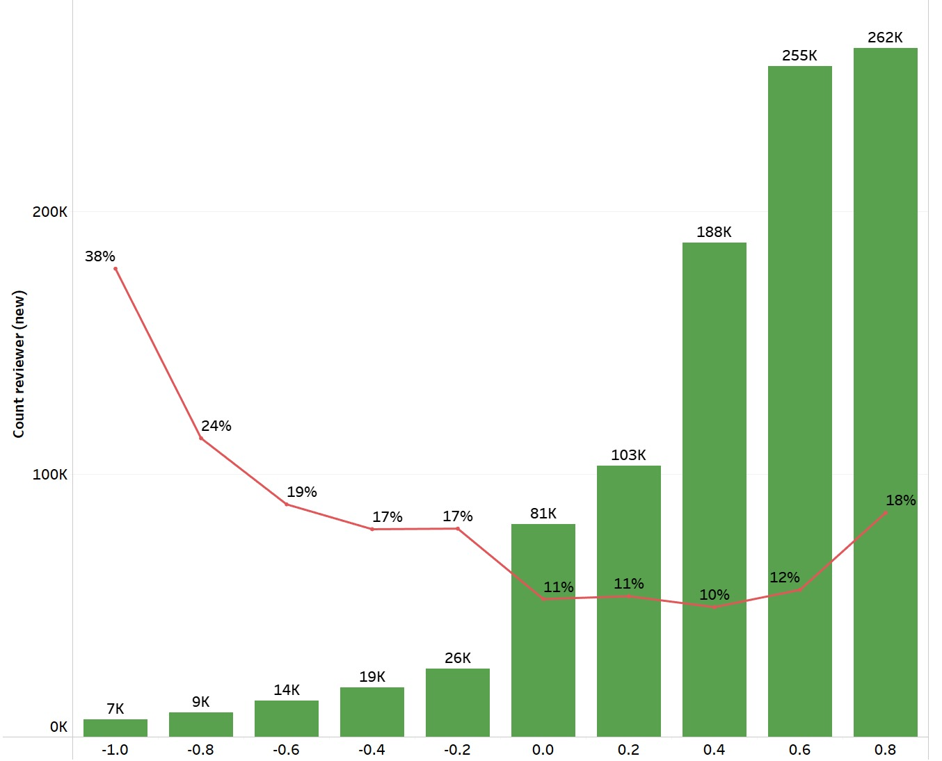
Our team: Team Cape Town
Data Driven Insights
Customer Sentiment: Negative reviews are more likely to be useful
% of Useful Reviews
Although more reviews tend to have a higher rating / positive sentiment, they are less likely to be helpful
Reviews with a low rating / negative experience are more likely to be useful
Count of Reviews
% of Helpful Reviews
NEGATIVE SENTIMENT
POSITIVE SENTIMENT
Sentiment Score
Notes:
FANNIE
Add customers with a negative exp -> helpful

Slide 8



Our team: Team Cape Town
Modelling Journey
Objective: To flag customer reviews as helpful or not
Approach: Assess the recency, frequency & content of labelled, historically helpful reviews to build a predictive model, to spot similar patterns in recently generated reviews
CRISP-DM Modelling Process
Pipeline
Helpful
Data Cleaning
& Pre-Processing
Not Helpful
01
02
03
04
Feature Engineering
Classification
Model Tuning & Evaluation
Data Generation
Features created at the customer, product & review levels
The winning model for the Binary Classifier is Light GBM.
Grid Search to identify best hyper parameters, optimizing for AUC
Customers reviewing products on the Amazon website
Notes:
ANAN

Slide 9
Our team: Team Cape Town
Modelling Journey
Feature Engineering
CUSTOMER LEVEL
CONTENT OF REVIEW
Total reviews per customer
Unique products reviewed
Recency & Frequency of reviewing
Word count of each review
Sentiment of review
Count of question marks, caps lock & exclamation points in review
34 Features that Help Identify What Makes a Review Useful
TEXT PREPROCESSING
SEASONALITY
Tokenizing words
Removing stop words
Count Vector (Word Frequency)
TF-IDF of frequently occurring words
Day of week / month of review creation
Black Friday, Boxing Day & Prime Week
PRODUCT LEVEL
DIVERGENCE METRICS
Reviews generated per product
General sentiment of product
Recency & Frequency of reviews
Does the review go against majority opinion?
Does the customer only review when they have a negative experience?
Notes:
ANAN

Slide 10

Our team: Team Cape Town
Modelling Journey
Model Improvement
Feature Selection + Hyperparameter Tuning
AUC: ~ 0.89
6
5
Fit Light GBM on Training Data
AUC: ~ 0.88
Added Features about the Content & Sentiment of Reviews
AUC: ~ 0.86
4
3
Added Date, Customer & Product Level Features
AUC: ~ 0.85
Applied Text Preprocessing Steps
AUC: ~ 0.83
2
1
Starting Model
AUC: ~ 0.82
* All AUC values here represent the AUC on the Kaggle leader board.
Notes:
AKIF
USE THE UPDATED AUC SCORES

Slide 11
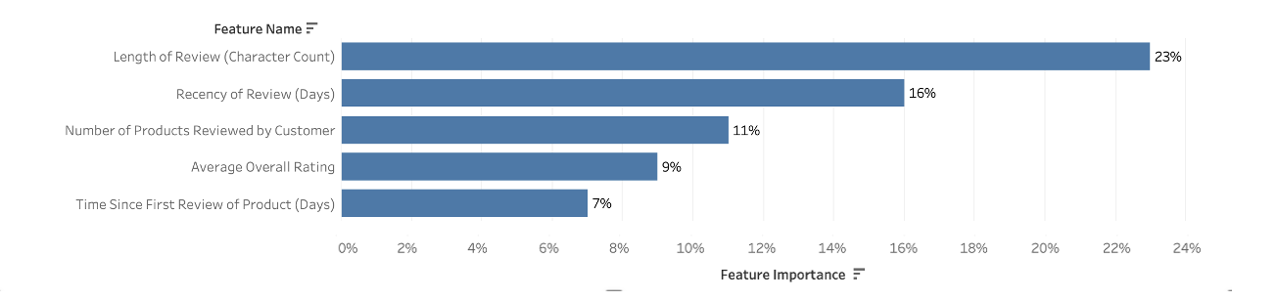
Our team: Team Cape Town
Model Evaluation
Feature Importance Chart of Winning Model
Only top 5 features shown
Notes:
AKIF

Slide 12
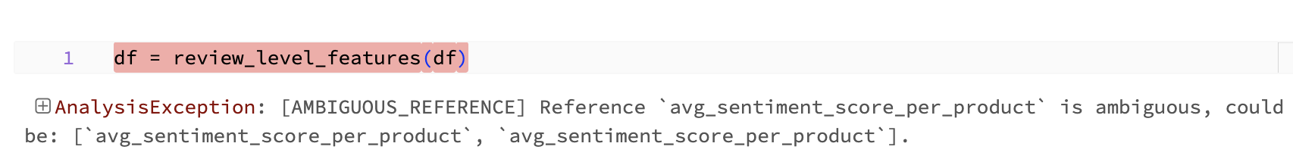
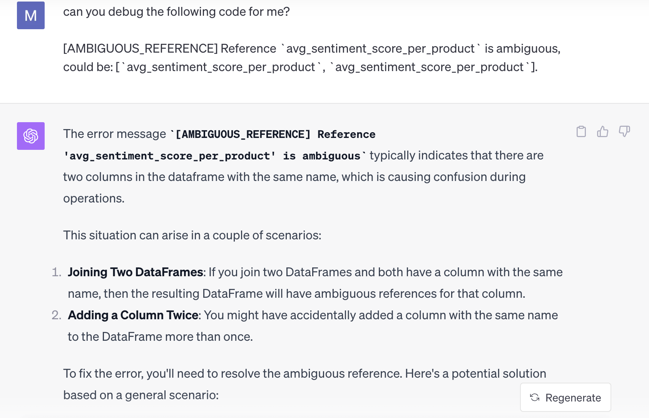
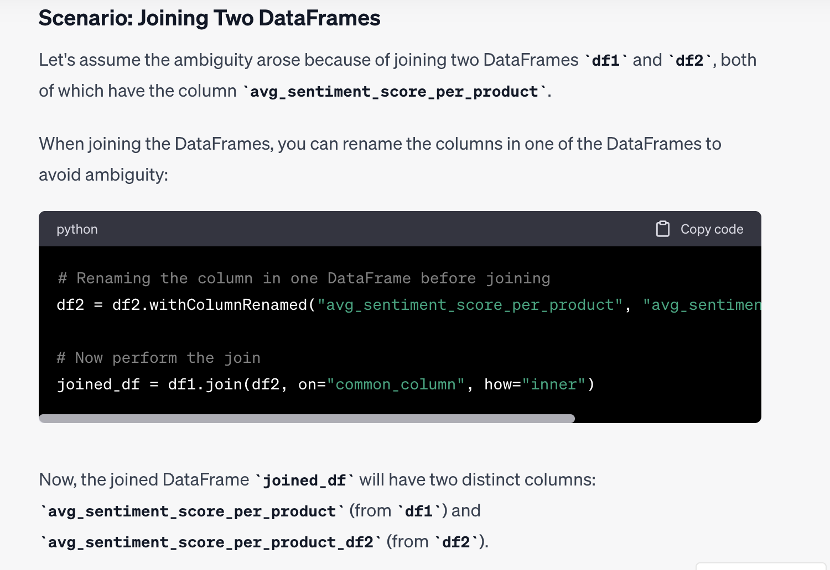
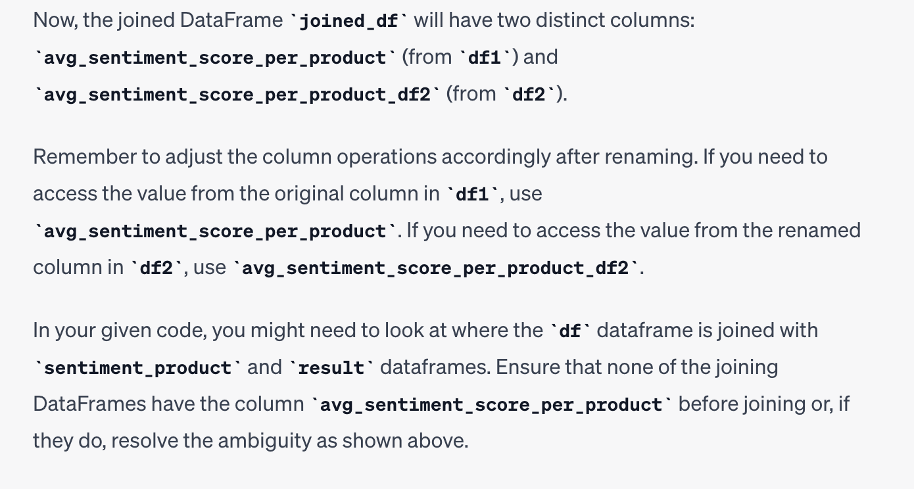
Our team: Team Cape Town
LLM Integration
LLM Integration
Debugging Code: Pasting the code and the error from the code provided a debugged version of the code, especially correcting for syntax issues.
Error Message:
LLM Solution:
Explanation of code snippet / solution
Explanation of error message
Code sample
Notes:
TERESA

Slide 13
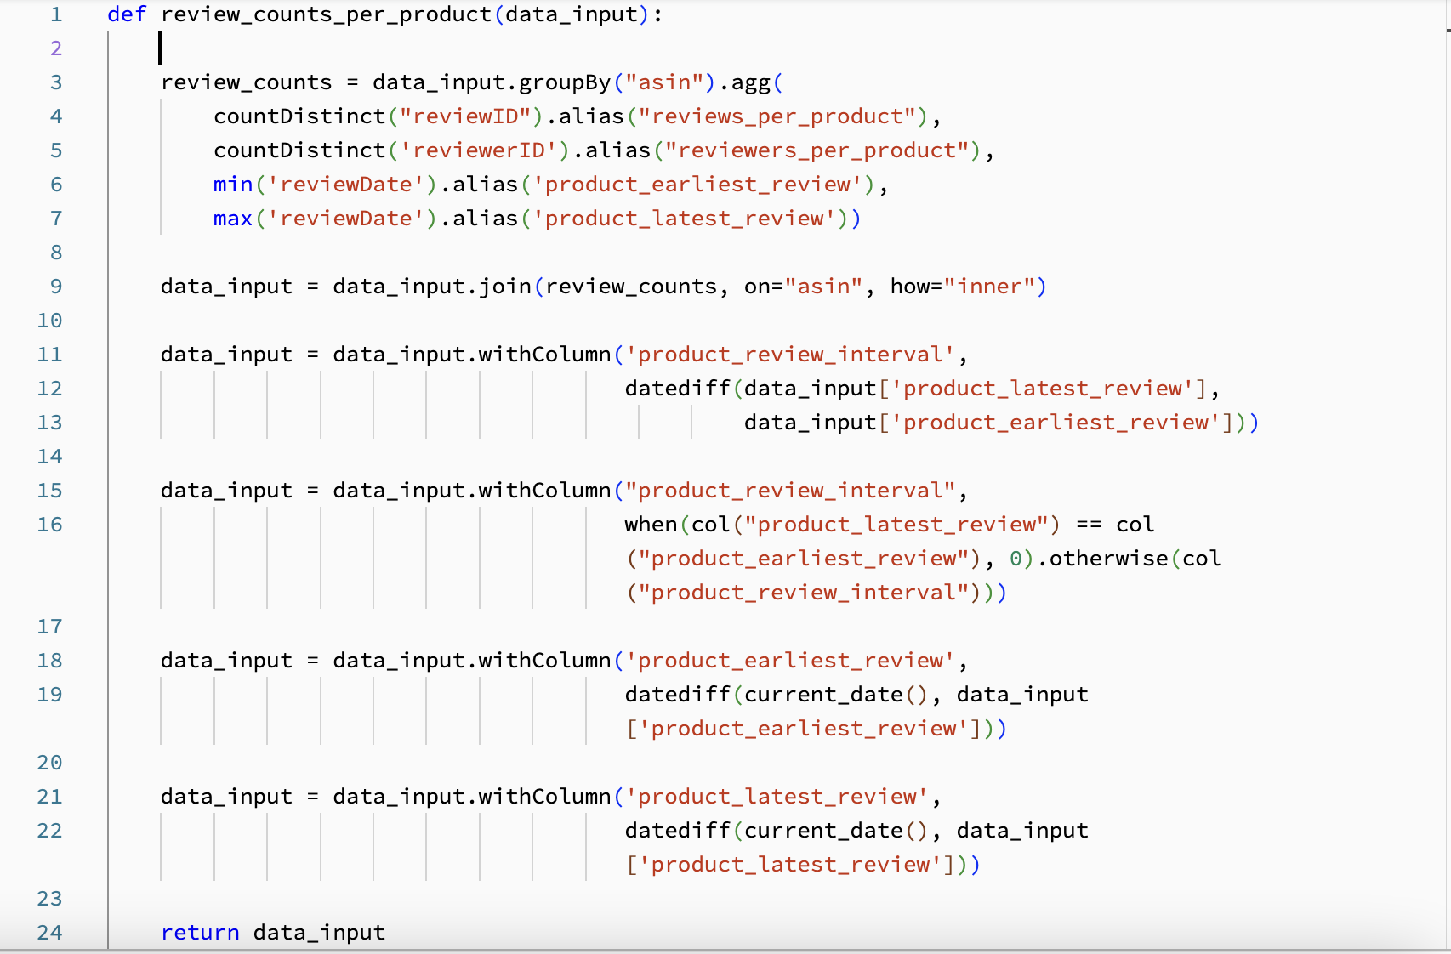
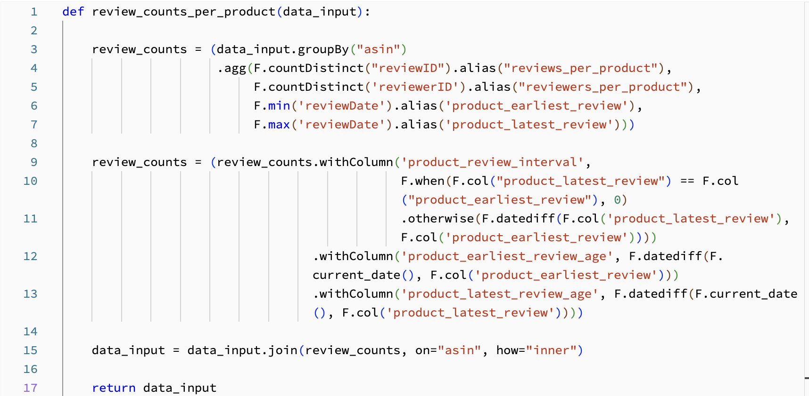
Our team: Team Cape Town
LLM Integration
LLM Integration
Code Refactoring: ChatGPT made the code better formatted, legible and easier to edit, increasing efficiency, as the code becomes more “readable”.
Pre LLM: 24 lines
Post LLM: 17 lines (~29% reduction)
Compact code
Multiple new columns created all at once
Notes:
TERESA

Slide 14
Our team: Team Cape Town
Key Takeaways
Learnings
Feature Engineering: The biggest improvement in model performance was brought about by adding features on how reviews are perceived by customers.
Feature Selection: Relevant features need to be included in the model. Too many / too little features can erode performance.
Fitting Different Models: Switching from Logistic Regression to Boosting models (Light GBM) improved model performance.
Cross Validation: Cross-validation to optimize for hyper parameter values (using Optuna, Grid Search) improved model performance.
Sampling Data: Data must be sampled to complete model training within a reasonable amount of time.
Notes:
TERESA

Slide 15
Thanks!

Slide 16
Our team: Team Cape Town
APPENDIX

Slide 17
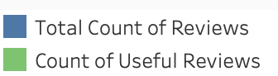
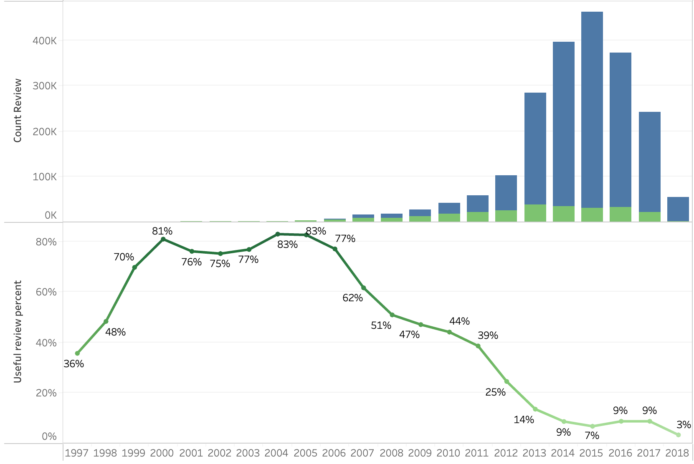
Our team: Team Cape Town
Data Driven Insights
Recency of Reviews: A recent review does not mean it is a helpful one!
Amazon extends beyond books and starts selling other items
Count of Reviews
More reviews are generated in recent years.
% of Useful Reviews
There is a drastic decline in useful reviews as more reviews get generated.
Year of Review Generation

Slide 18
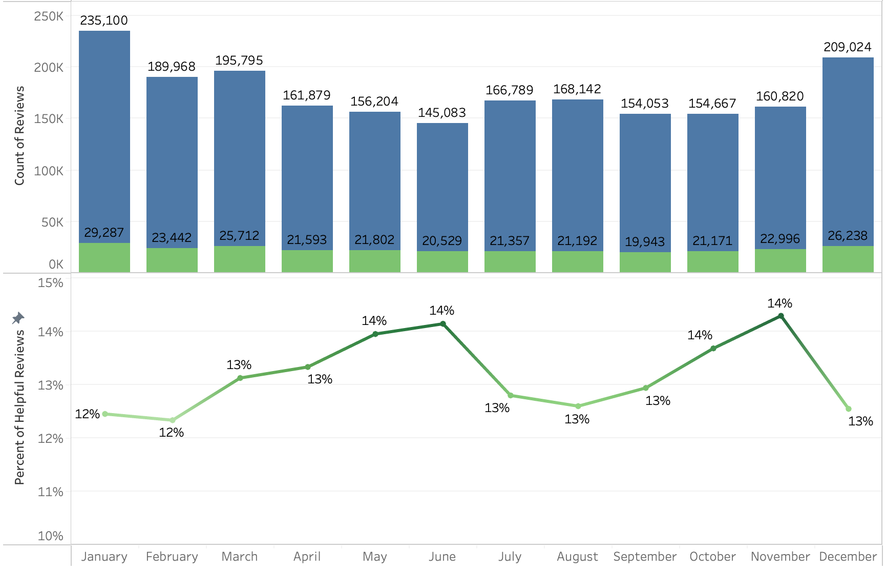
Our team: Team Cape Town
Data Driven Insights
Seasonality of Reviews: Review generation does not follow a seasonal trend
Review generation slightly increases in Dec & Jan, corresponding to Boxing Day & New Years. There is no seasonality in review creation.
Count of Reviews
The creation of useful reviews follows a steady trend, without demonstrating any seasonality.
% of Helpful Reviews

Slide 19
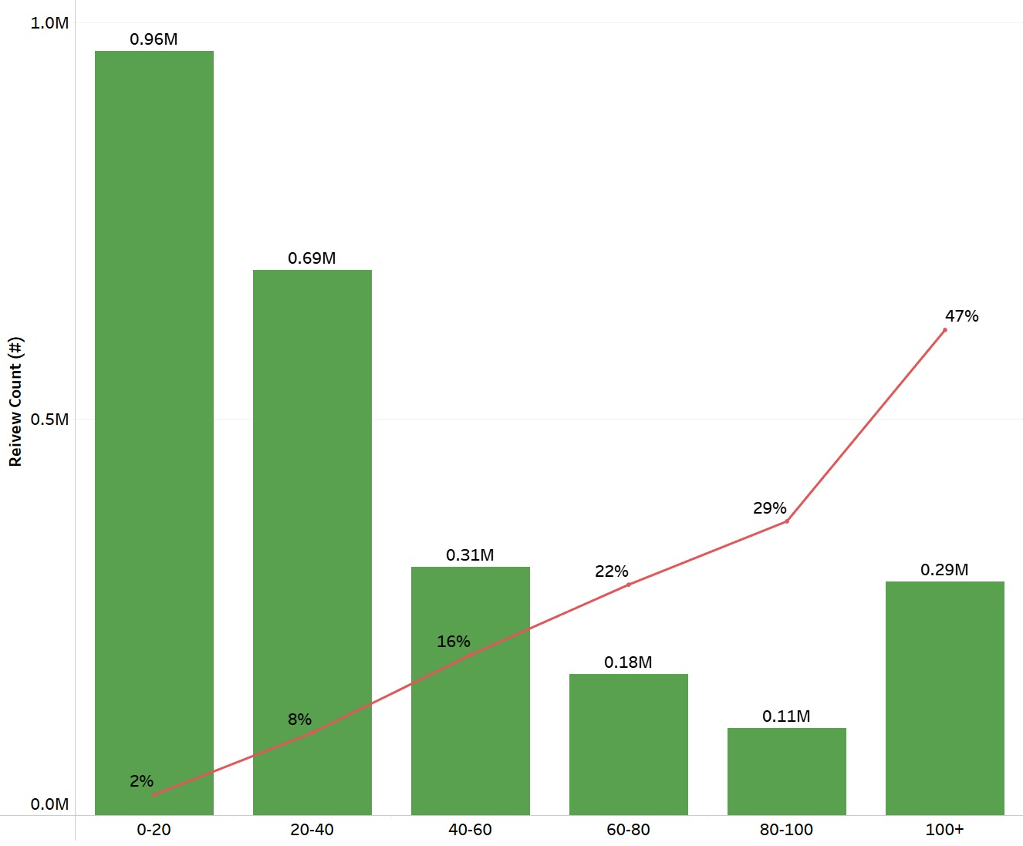
Our team: Team Cape Town
Data Driven Insights
Length of Reviews: Longer reviews tend to be more helpful
% of Useful Reviews
More reviews tend to be short
Longer reviews tend to be more helpful
Count of Reviews
Length of Review (Word Count)

Slide 20
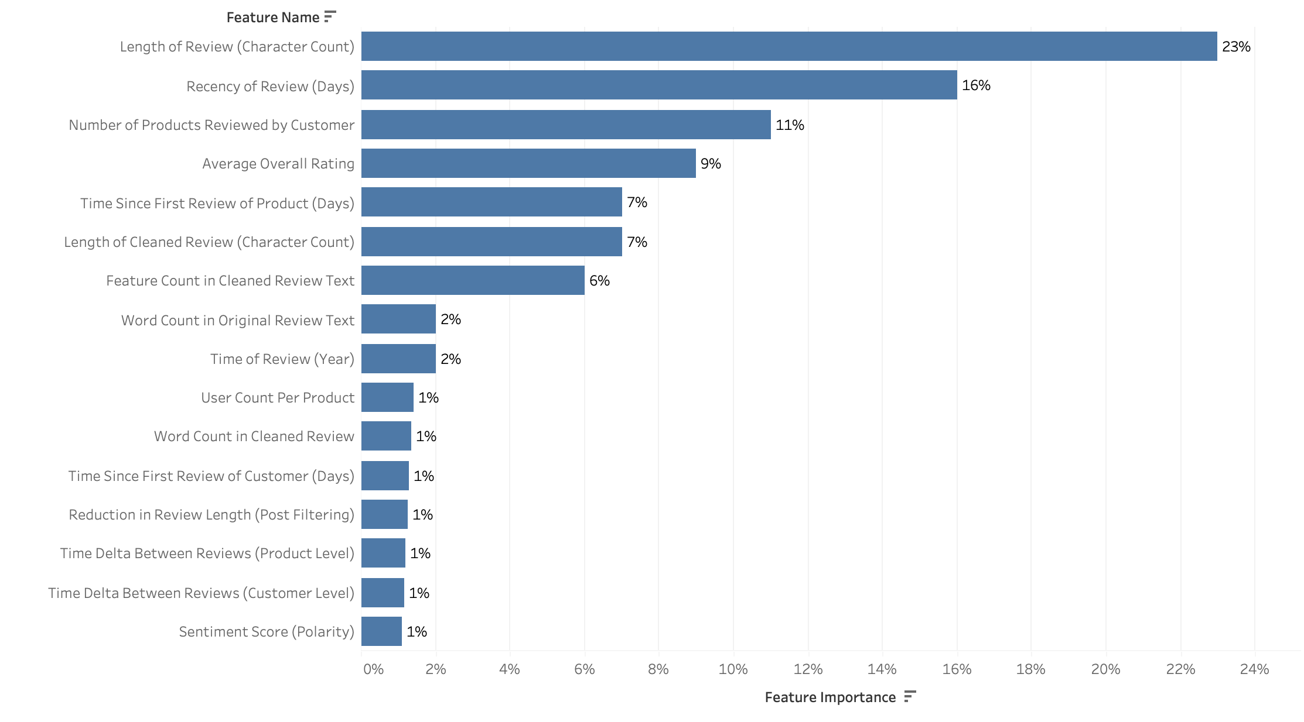
Our team: Team Cape Town
Model Evaluation
Feature Importance Chart of Winning Model
Notes:
AKIF

